Slide 1

Query Optimizer
Execution Plan Cost Model
Joe Chang jchang6@yahoo.com
www.qdpma.com , www.solidq.com

Slide 2


Scope - Query Optimizer
Parse SQL
Execution Plans
Cost Model
  Rows and pages in each operation
Data Distribution Statistics
  Estimate rows and pages
Sources – David Dewitt, Conor Cunningham

Slide 3
Execution Plan Cost Model
Index Seek + Key Lookup – Table Scan
Joins – Loop, Hash, Merge
Updates (Includes Insert & Delete)
  Really complicated, not covered here
Parallel Execution Plans

Slide 4
Query Optimizer References
Conor Cunningham
  Chapter in Inside SQL Server
  Conor vs. SQL
  http://blogs.msdn.com/b/conor_cunningham_msft/
David Dewitt
  PASS 2010 Summit Keynote
  Search: Microsoft Jim Gray Systems Lab
http://www.slideshare.net/GraySystemsLab/pass-summit-2010-keynote-david-dewitt
http://www.slideshare.net/GraySystemsLab/pass-summit-2010-keynote-david-dewitt/download

Slide 5
My material
http://www.qdpma.com/CBO/SQLServerCostBasedOptimizer.html
http://www.qdpma.com/zPresentations.html

Slide 6
Paul White – Page Free Space
http://sqlblog.com/blogs/paul_white/default.aspx
Inside the Optimiser: Constructing a Plan – Part 4
  http://sqlblog.com/blogs/paul_white/archive/2010/07/31/inside-the-optimiser-constructing-a-plan-part-4.aspx
  DBCC RULEON/RULEOFF
Inside the Optimizer: Plan Costing
  http://sqlblog.com/blogs/paul_white/archive/2010/09/01/inside-the-optimizer-plan-costing.aspx
DBCC TRACEON (3604); -- Show DBCC output
DBCC SETCPUWEIGHT(1E0); -- Default CPU weight
DBCC SETIOWEIGHT(0.6E0); -- I/O multiplier = 0.6
DBCC SHOWWEIGHTS; -- Show the settings

Slide 7
Why this is Useful?
When does the QO use:
  an index versus table scan
  Loop Join or Hash/Merge with Scan?
Is there a difference between the
  Cost Model and True Cost Structure?
  Should I use query hints
Parallel Execution Strategy
  Modern servers – 64+ cores

Slide 8
SQL Server Books Online
Query Governor Cost Limit
Cost Threshold for Parallelism
Query cost refers to the estimated elapsed time, in seconds, required to complete a query on a specific hardware configuration.
The cost refers to an estimated elapsed time in seconds required to run the serial plan on a specific hardware configuration. … SQL Server creates and runs a parallel plan for a query only when the estimated cost to run a serial plan for the same query is higher than the value set in cost threshold for parallelism.

Slide 9


Adventure Works Example

Slide 11
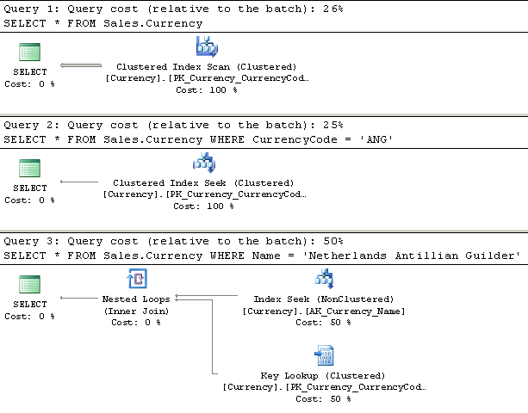
Estimated Execution Plan

Slide 12
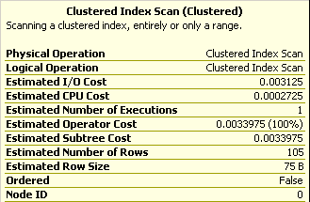
Clustered Index Scan

Slide 13
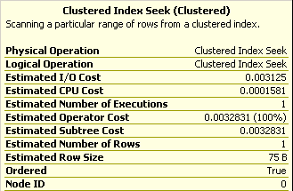
Index Seek

Slide 14
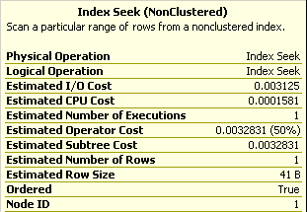
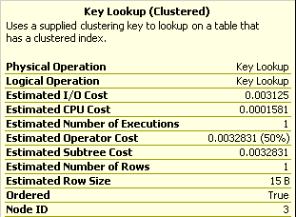
Index Seek + Key Lookup

Slide 15
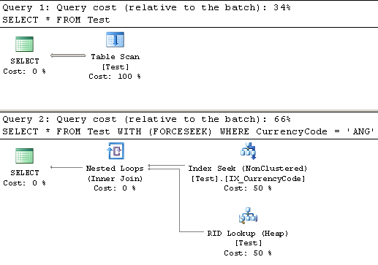
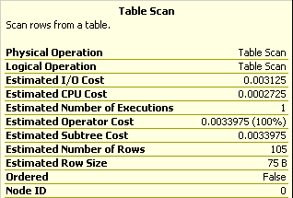
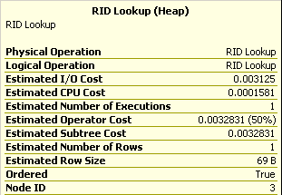
Heap Table

Slide 16
Heap Operations

Slide 17
The Formula – Seek, Scan
(Clustered) Index Scan, Table Scan, Index Seek
IO Cost 0.003125 + 0.00074074 per page
CPU Cost 0.0001581 + 0.0000011 per row

Slide 18
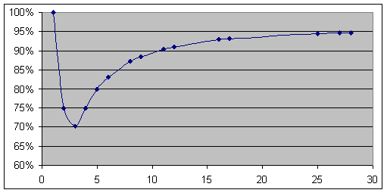
Key Lookup (& Loop Join)
Key/RID Lookup, Nested Loops Join
IO Cost 0.003125 x % that require Lookup
CPU Cost 0.0001581 per Lookup
0.0000011 per additional rows

Slide 19
IO Cost Model Sequential - Random
Cost is elapsed time in seconds
Random 0.003125 = 1/320
Sequential 0.00074074… = 1/1350
Random: 320 IOPS
Sequential 1350 pages/sec, or 10.8MB/s

Slide 20
Key Lookup – Scan Cross over
Key Lookup rows to pages scanned ratio
1 Key Lookup cost approximately 4 pages in scan operation
Non-parallel plan, with other costs
  Cross-over approx 3.5 pages per KL row
Parallel Plan
  Closer to 4 pages per Key Lookup row

Slide 22
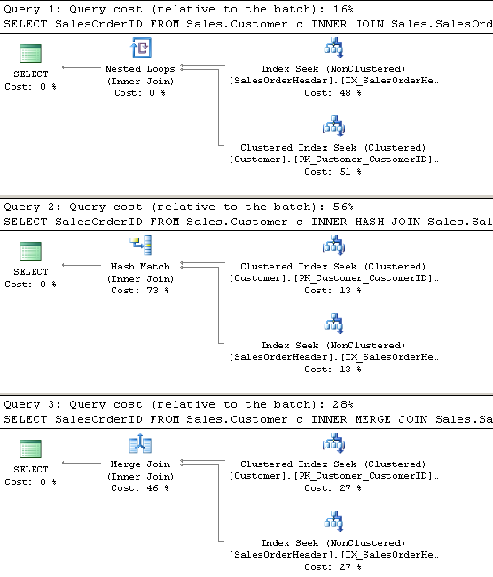
Loop, Hash and Merge Joins

Slide 23
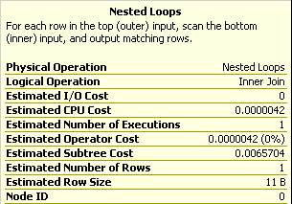
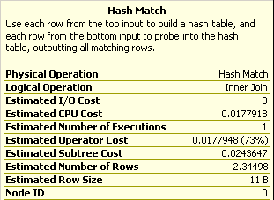
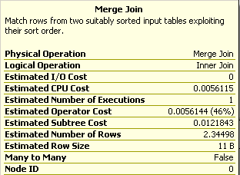
L H M

Slide 24
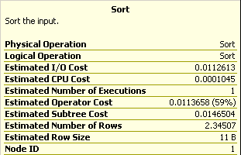
Sort

Slide 25
Loop Hash and Merge
Cost Fixed Incremental
Loop ~0.0 0.00000418 + Seek
+ seek cost: 0.003125 IO, 0.0001581 CPU
Hash ~0.017780 0.00001526*
Merge ~0.005607 0.00000238†
Many-to-Many Merge 0.00004738
Sort ~0.011261
* Hash incremental cost depends on inner/outer source size
† Merge join incremental is per IS & OS row?
Merge + Sort fixed cost approx same as Hash fixed cost

Slide 26
Loop, Hash, Merge
Cost Fixed Incremental
Loop Zero High
Hash High Medium
Merge Medium Low
Merge Join requires both source rows in index sorted order.
Regular Merge only for 1-1 or 1-many
Many-to-many merge join is more expensive

Slide 27


Slide 28
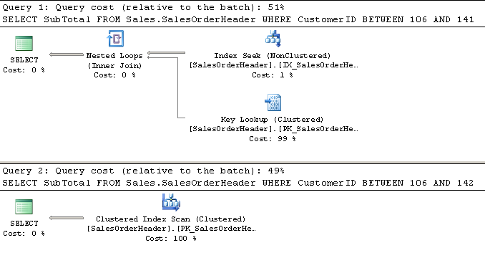

Slide 29
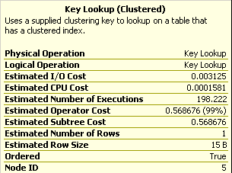
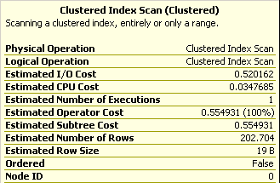

Slide 30
Plan Cross-over Theory
Index Seek + Key Lookup
Cost
Table Scan
Rows

Slide 31
Theory & Actual?
KL Actual!
KL Theory
Cost
Table Scan
KL alternate reality?
Rows

Slide 32
Plan and Actual IO
Random Sequential Ratio
Plan 320 1,350 (10.8M/s) 4.2187
Current HD 200* 12,800 (100MB/s) 64*
SAN 200 1,280 (10MB/s) 6.4
SSD 20,000 25,000 ~1
*Note: original slide incorrectly listed 640:1

Slide 34
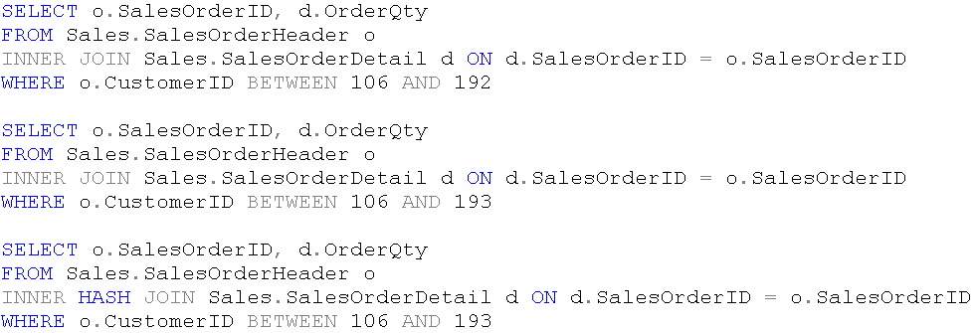
Loop, Hash & Merge

Slide 35
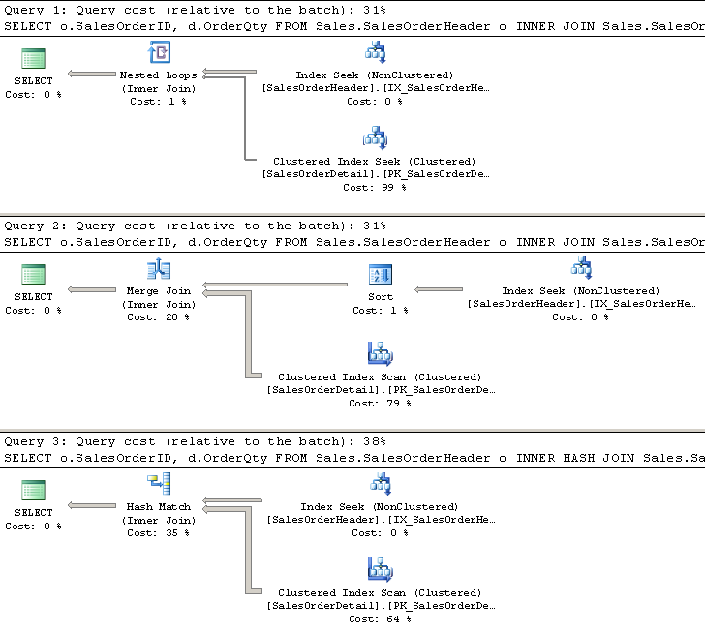

Slide 36
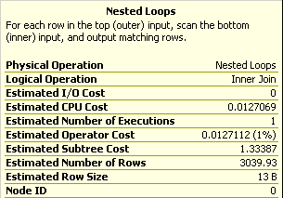
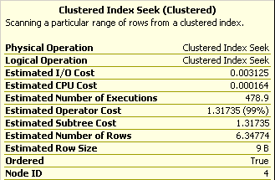
Loop Join

Slide 37
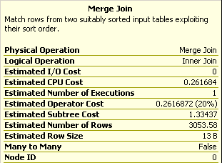
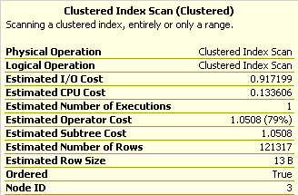
Merge Join

Slide 38
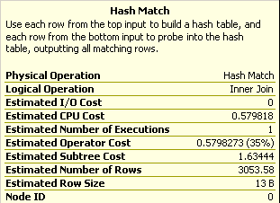
Hash Join

Slide 39
Insert, Update & Delete
Really complicated
  See material from Conor
For large number of rows (25%?
  Consider dropping indexes

Slide 40
Delete Rows
Index foreign keys when:
  Deletes from primary table are frequent

Slide 42
Parallel Execution
Parallel Execution
Parallelism Gather, Repartition, Distribute Streams,
Partitions

Slide 43

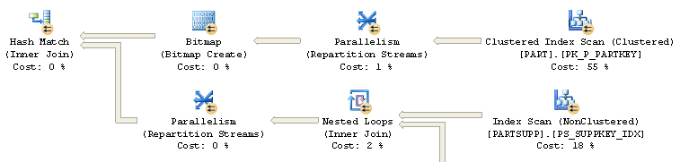
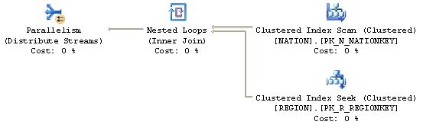
Parallel Execution Plan

Slide 44




Parallel Operations
Distribute Streams
  Non-parallel source, parallel destination
Repartition Streams
  Parallel source and destination
Gather Streams
  Destination is non-parallel
Bitmap

Slide 45
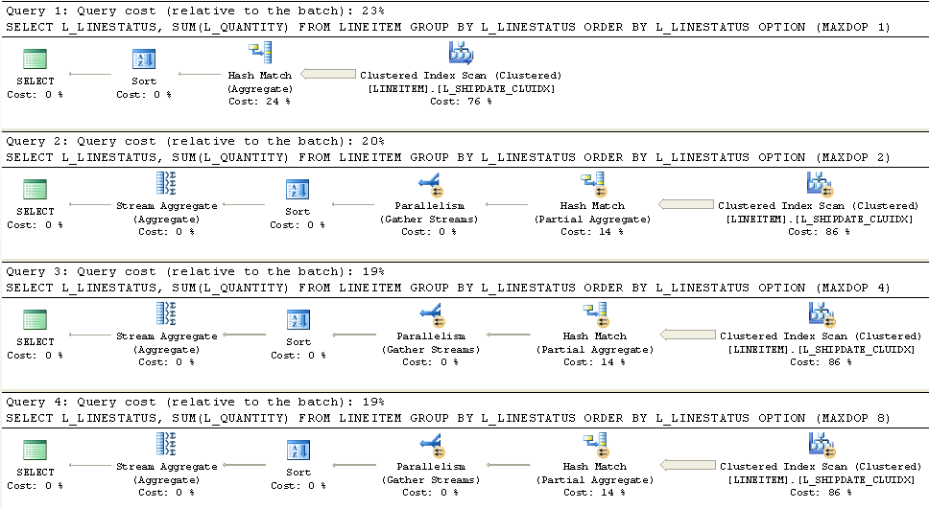
Scan

Slide 46
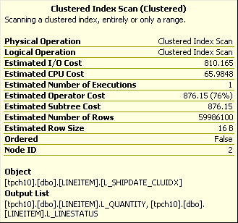
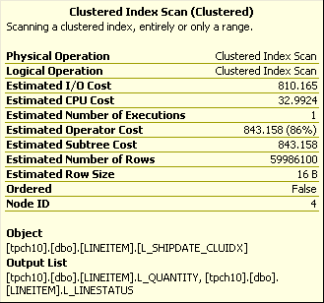


2X
IO Cost same
CPU reduce by degree of parallelism, except no reduction for DOP 16
DOP 1
DOP 2
8X
4X
IO contributes most of cost!
DOP 4
DOP 8

Slide 47

DOP 8
DOP 16

Slide 48
IO Cost is the same
CPU cost reduced in proportion to degree of parallelism, last 2X excluded?
On a weak storage system, a single thread can saturate the IO channel,
Additional threads will not increase IO (reduce IO duration).
A very powerful storage system can provide IO proportional to the number of threads. It might be nice if this was optimizer option?
The IO component can be a very large portion of the overall plan cost
Not reducing IO cost in parallel plan may inhibit generating favorable plan,
i.e., not sufficient to offset the contribution from the Parallelism operations.
A parallel execution plan is more likely on larger systems (-P to fake it?)

Slide 50
Too Many Indexes
Complicates Query Optimization
  Too many possible execution plan
Large Updates – Maintenance
  Consider dropping indexes

Slide 51
Parameters and Variables
Unknown, remote source
  Remote Scan: 10,000 rows
  Remote Seek xxx rows
Unknown >, <, BETWEEN
  > or <: 30% of rows
  BETWEEN: 1/10 of rows

Slide 52
Temp tables and Table Variables

